Slide 1
Lecture 25: Advanced Topics
Instructor: Yang Xu
Slides inspired by the deeplearning.ai series courses on Coursera.org

Slide 2
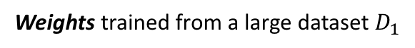
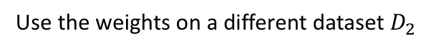
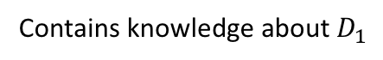
Transfer learning
Building a NN model without training all the weights from scratch (from random initialization)
Weights trained from a large dataset $D_{1}$
Use the weights on a different dataset $D_{2}$
Contains knowledge about $D_{1}$
Reuse the knowledge might be useful

Slide 3
Transfer learning example
Build your own cat image classifier:
0: Tom
1: Garfield
Not enough training data!
What shall we do?
Solution: download the weights of already trained image classifiers on different dataset, e.g., ImageNet etc.
Softmax: 1000
Tom
Garfield
Neither
Softmax: 3
Freeze parameters in these layers
Just train the new softmax layer

Slide 4
Transfer learning example
If you have a moderate training set
Tom
Garfield
Neither
Partially freeze parameters
Set this part trainable
If you have a really large training set
Tom
Garfield
Neither
Just use the downloaded weights to initialize and set all of them trainable

Slide 5
One shot learning
Face recognition problem:
Database of face images from K persons
Take an input face image
Recognize if the input is in the database
Difficulty: recognize the person given one image
Cap
Task: Learning from one example to recognize the person again
Tony
Does not work well using typical CNN models
Lack of data!
Have to retrain for new faces
Nat
?
Banner

Slide 6
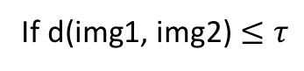
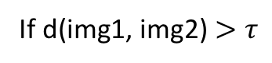
Solution: Learning a similarity function
d(img1, img2) → measures the difference between images
If d(img1, img2) $≤τ$
Same person
If d(img1, img2) $>τ$
Different person
9
0.1
10
8

Slide 7
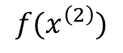
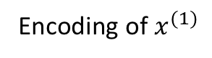
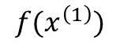
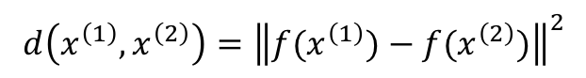
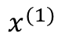
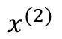
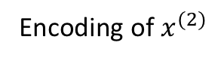
How to learn the similarity function?
User Siamese network
Encoding of $x^{(1)}$
$$f(x^{\left(1\right)})$$
$$x^{(1)}$$
Define:
$$d\left(x^{\left(1\right)},x^{\left(2\right)}\right)={\left\|f(x^{\left(1\right)})−f(x^{\left(2\right)})\right\|}^{2}$$
Encoding of $x^{(2)}$
$$f(x^{\left(2\right)})$$
$$x^{(2)}$$

Slide 8
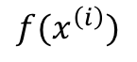
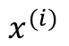
Learning objective
$$f(x^{\left(i\right)})$$
$$x^{(i)}$$
Train the parameters of the CNN/NN so that :
If $x^{\left(1\right)},x^{\left(2\right)}$ are the same person, ${\left\|f(x^{\left(1\right)})−f(x^{\left(2\right)})\right\|}^{2}$ is small
If $x^{\left(1\right)},x^{\left(2\right)}$ are different persons, ${\left\|f(x^{\left(1\right)})−f(x^{\left(2\right)})\right\|}^{2}$ is big

Slide 9
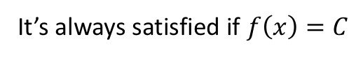
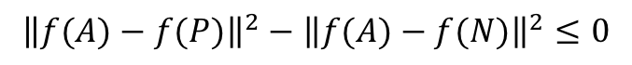
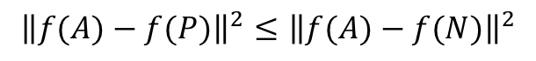
Training a Siamese network
Use the trplet loss function
“Triplet”: looking at 3 images at a time
Anchor
Positive
Anchor
Negative
We want:
$${\left\|f(A)−f(P)\right\|}^{2}≤{\left\|f(A)−f(N)\right\|}^{2}$$
$${\left\|f(A)−f(P)\right\|}^{2}−{\left\|f(A)−f(N)\right\|}^{2}≤0$$
It’s always satisfied if $f\left(x\right)=C$
$${\left\|f(A)−f(P)\right\|}^{2}−{\left\|f\left(A\right)−f\left(N\right)\right\|}^{2}+α≤0$$
Margin

Slide 10
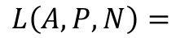
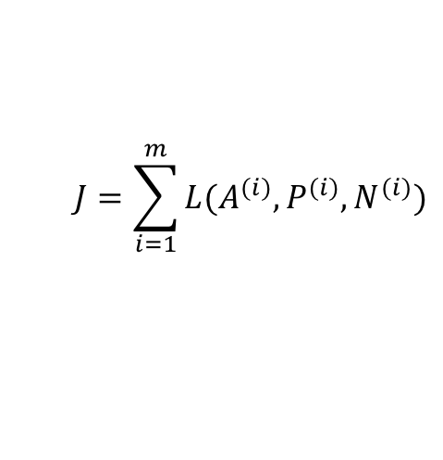
Triplet loss function
Given 3 images A, P, N:
$$L\left(A, P, N\right)=$$
$$\max\left({\left\|f(A)−f(P)\right\|}^{2}−{\left\|f\left(A\right)−f\left(N\right)\right\|}^{2}+α, 0\right)$$
The cost:
$$J=\sum_{i=1}^{m}{L(A^{(i)},P^{(i)},N^{(i)})}$$
Example: 10k images from 1k persons
Need to construct triplets out of the data
How to choose triplets?
Choose triplets that are “hard” to train on, i.e., ${\left\|f(A)−f(P)\right\|}^{2}≈{\left\|f\left(A\right)−f\left(N\right)\right\|}^{2}$
So that the loss is positive, and so the NN can actually learn

Slide 11
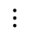
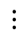
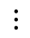
Training on triplets
A
P
N
$$⋮$$
$$⋮$$
$$⋮$$

Slide 12
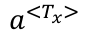
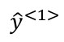
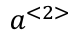
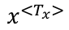
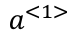
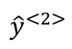
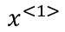
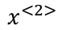
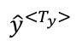
Machine Translation
Using sequence to sequence model
What a … pleasant day
Encoder
$${\hat{y}}^{<1>}$$
$${\hat{y}}^{<2>}$$
$${\hat{y}}^{<T_{y}>}$$
$$a^{<1>}$$
$$a^{<2>}$$
…
$$a^{<T_{x}>}$$
…
$$x^{<1>}$$
$$x^{<2>}$$
$$x^{<T_{x}>}$$
Decoder
多 么 … 愉 快 的 一 天

Slide 13
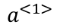
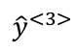
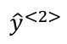
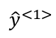
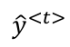
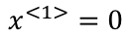
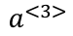
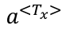
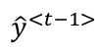
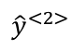
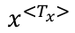
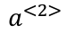
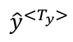
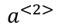
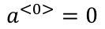
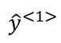
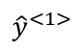
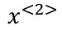
Compared to language modeling
$${\hat{y}}^{<1>}$$
$${\hat{y}}^{<2>}$$
$${\hat{y}}^{<3>}$$
$${\hat{y}}^{<t>}$$
Language modeling:
$$a^{<0>}=0$$
$$a^{<1>}$$
$$a^{<2>}$$
$$a^{<3>}$$
…
$$a^{<3>}$$
$$x^{<1>}=0$$
$${\hat{y}}^{<1>}$$
$${\hat{y}}^{<2>}$$
$${\hat{y}}^{<t−1>}$$
similar architecture
$${\hat{y}}^{<1>}$$
$${\hat{y}}^{<2>}$$
$${\hat{y}}^{<T_{y}>}$$
Machine translation:
$$a^{<1>}$$
$$a^{<2>}$$
…
$$a^{<T_{x}>}$$
…
A conditional language model
$$x^{<1>}$$
$$x^{<2>}$$
$$x^{<T_{x}>}$$

Slide 14
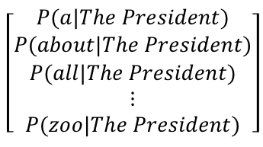








Difference from language modeling
E.g., ${\hat{y}}^{<1>}=The$
$${\hat{y}}^{<2>}=President$$
$${\hat{y}}^{<3>}=is$$
$${\hat{y}}^{<t>}= <EOS>$$
LM uses random sampling over $p(y^{<t>}|x)$
$$\left[\begin{aligned}P(a) \\ P(about) \\ P(all) \\ ⋮ \\ P(zoo)\end{aligned}\right]$$
$$\left[\begin{aligned}P(a|The) \\ P(about|The) \\ P(all|The) \\ ⋮ \\ P(zoo|The)\end{aligned}\right]$$
$$\left[\begin{aligned}P(a|The President) \\ P(about|The President) \\ P(all|The President) \\ ⋮ \\ P(zoo|The President)\end{aligned}\right]$$
$$\left[\begin{aligned}P(a|The President is⋯) \\ P(about|The President is⋯) \\ P(all|The President is⋯) \\ ⋮ \\ P(zoo|The President is ⋯)\end{aligned}\right]$$
$${\hat{y}}^{<1>}$$
$${\hat{y}}^{<2>}$$
$${\hat{y}}^{<3>}$$
$${\hat{y}}^{<t>}$$
$$a^{<0>}=0$$
$$a^{<1>}$$
$$a^{<2>}$$
$$a^{<3>}$$
…
$$a^{<3>}$$
$$x^{<1>}=0$$
$${\hat{y}}^{<1>}$$
$${\hat{y}}^{<2>}$$
$${\hat{y}}^{<t−1>}$$

Slide 15

Difference from language modeling
MT needs to find the most likely translation over $p(y^{<1>},…,y^{<T_{y}>}|x)$
Jane visite l’Afrique en septembre.
→ Jane is visiting Africa in September.
Pick the mostly like translation:
→ Jane is going to be visiting Africa in September.
$$\arg{\max_{y^{<1>},…,y^{<T_{y}>}}{p(y^{<1>},…,y^{<T_{y}>}|x)}}$$
→ In September, Jane will visit Africa.
→ Her African friend welcomed Jane in September.

Slide 16









Greedy search?
$$\arg{\max_{{\hat{y}}^{<1>}}{p({\hat{y}}^{<1>}|x)}}$$
$$\arg{\max_{{\hat{y}}^{<2>}}{p({\hat{y}}^{<2>}|x,{\hat{y}}^{<1>})}}$$
$${\hat{y}}^{<1>}$$
$${\hat{y}}^{<2>}$$
$${\hat{y}}^{<T_{y}>}$$
$$a^{<1>}$$
$$a^{<2>}$$
…
$$a^{<T_{x}>}$$
…
$$x^{<1>}$$
$$x^{<2>}$$
$$x^{<T_{x}>}$$
→ Jane is visiting Africa in September.
$$p\left(visiting | Jane, is\right)<p\left(going | Jane, is\right)$$
→ Jane is going to be visiting Africa in September.
Choosing the most likely word does not necessarily give the best translation

Slide 17









Beam search algorithm
with beam width $B=3$
Step 1
Step 2
$$\left[\begin{aligned}a \\ ⋮ \\ September \\ ⋮\end{aligned}\right]$$
After step 2
$$\left[\begin{aligned}a \\ ⋮ \\ in \\ ⋮ \\ Jane \\ ⋮ \\ September \\ ⋮ \\ zoo\end{aligned}\right]$$
$$\arg{\max_{{\hat{y}}^{<2>}}{p({\hat{y}}^{<2>}|x, “in”)}}$$
The top 3 candidates for the first two words are:
10k
$$\left[\begin{aligned}a \\ ⋮ \\ is \\ ⋮ \\ visits \\ ⋮\end{aligned}\right]$$
“in September”
“Jane is”
“Jane visits”
$$\arg{\max_{{\hat{y}}^{<2>}}{p({\hat{y}}^{<2>}|x, “Jane”)}}$$
Repeat until “<EOS>” is reached
Pick the top 3 candidates among 10k words
$$\left[\begin{aligned}a \\ ⋮ \\ zoo\end{aligned}\right]$$
$$\arg{\max_{{\hat{y}}^{<2>}}{p({\hat{y}}^{<2>}|x, “September”)}}$$
$B=1$ → greedy search
Pick the top 3 candidates among 30k words

Slide 18




Evaluating machine translation
BLEU (Bilingual Evaluation Understudy) score
BLEU score:
$$P_{1}=\frac{\sum_{unigram∈\hat{y}}{{Count}_{clip}(unigram)}}{\sum_{unigram∈\hat{y}}{Count(unigram)}}$$
For unigrams:
French: Le chat est sur le tapis.
Ref 1 (from human): The cat is on the mat.
$$P_{n}=\frac{\sum_{ngram∈\hat{y}}{{Count}_{clip}(ngram)}}{\sum_{ngram∈\hat{y}}{Count(ngram)}}$$
For n-grams:
Ref 2 (from human): There is a cat on the mat.
A bad MT: The the the the the the the
A better MT: The cat the cat on the mat
maximum count in a ref
$$\frac{{Count}_{clip}(“the”)}{ Count(“the”)}=\frac{2}{7}$$
Modified precision of “the”
$$\frac{{Count}_{clip}(“the”)}{ Count(“the”)}=\frac{2}{3}$$
Modified precision of “the” =
Papineni et al. 2002. BLEU: a method for automatic evaluation of machine translation

Slide 19
Attention model: improving sequence to sequence model
Motivation: the problem of long sentences
“他们坐在饭店的露台上，不少渔夫拿老人开玩笑，老人并不生气。另外一些上了些年纪的渔夫望着他，感到难受。不过他们并不流露出来，只是斯文地谈起海流，谈起他们把钓索送到海面下有多深，天气一贯多么好，谈起他们的见闻。”
“They are sitting on the terrace of the hotel. Many fishermen are joking with the old man. The old man is not angry. Other fishermen who were older were looking at him and felt uncomfortable. However, they did not reveal it. They only talked about the currents in a gentle way. They talked about how deep they sent the ropes to the surface of the sea, how good the weather has always been, and talked about their stories.”
BLEU
Intuition:
Different words in output sentence should pay different amount of attention to different parts of input sequence
Sentence length
Notes:
One of the most influential ideas in deep learning

Slide 20





































Attention model
$$C^{<1>}=\sum_{t^{′}}{α^{<1,t^{′}>}a^{<t^{′}>}}$$
$${\hat{y}}^{<1>}$$
$${\hat{y}}^{<2>}$$
$${\hat{y}}^{<3>}$$
$${\hat{y}}^{<t>}$$
Decoder:
$$\sum_{t^{′}}{α^{<1,t^{′}>}}=1$$
$$S^{<0>}$$
$$S^{<1>}$$
$$S^{<2>}$$
$$S^{<3>}$$
…
$$S^{<t>}$$
$α^{<t, t^{′}>}$ is the amount of “attention” $y^{<t>}$ should pay to $a^{<t^{′}>}$
$$C^{<1>}$$
$$C^{<2>}$$
$$C^{<3>}$$
$$C^{<t>}$$
$$α^{<1,1>}$$
$$α^{<1,2>}$$
$$α^{<1,5>}$$
$$α^{<1,3>}$$
$$α^{<1,4>}$$
Encoder:
$$a^{<1>}$$
$$a^{<2>}$$
$$a^{<3>}$$
$$a^{<4>}$$
$$a^{<5>}$$
$${\vec{a}}^{<1>}$$
$${\vec{a}}^{<2>}$$
$${\vec{a}}^{<3>}$$
$${\vec{a}}^{<4>}$$
$${\vec{a}}^{<5>}$$
$${\overset{⃖}{a}}^{<1>}$$
$${\overset{⃖}{a}}^{<2>}$$
$${\overset{⃖}{a}}^{<3>}$$
$${\overset{⃖}{a}}^{<4>}$$
$${\overset{⃖}{a}}^{<5>}$$
$$x^{<1>}$$
$$x^{<2>}$$
$$x^{<3>}$$
$$x^{<4>}$$
$$x^{<5>}$$
Jane
visite
l’Afreque
en
septembre
Notes:
Alpha parameters tell us how much the context would depend on the features

Slide 21




















Computing attention parameters
$α^{<t, t^{′}>}$: the amount of “attention” $y^{<t>}$ should pay to $a^{<t^{′}>}$
$${\hat{y}}^{<t−1>}$$
$${\hat{y}}^{<t>}$$
$$α^{<t, t^{′}>}=\frac{\exp{(f^{<t,t^{′}>})}}{\sum_{t^{′}=1}^{T_{x}}{\exp{(f^{<t,t^{′}>})}}}$$
$$S^{<t−1>}$$
$$S^{<t>}$$
$f^{<t,t^{′}>}$ is an unknown function
$$C^{<t−1>}$$
$$C^{<t>}$$
Practically, use the output of a shallow neural network
$$α^{<t, 1>}$$
$$α^{<t, 2>}$$
$$α^{<t,T_{x}>}$$
$S^{<t−1>}$
$$a^{<1>}$$
$$a^{<1>}$$
$$a^{<T_{x}>}$$
$f^{<t,t^{′}>}$
…
$a^{<t^{′}>}$
$$x^{<1>}$$
$$x^{<T_{x}>}$$
$$x^{<1>}$$
“In backprop and gradient descent we trust”

Slide 22
Our journey
Linear regression & logistic regression → gradient descent
Computation graph → backprop → deep neural networks
Tuning deep neural networks
Convolutional neural networks
Recurrent neural networks
Principal component analysis & clustering
Support vector machines
Generative learning algorithms & advanced topics
In backprop and gradient descent we trust
In human knowledge/intuition we trust

Slide 23
Word cloud of all lecture slides

Slide 24
Thank you!

